Slide 1


IPUMS CONTEXTUAL
DETERMINANTS
OF HEALTH(CDOH)

Slide 2
Team Members
Developing lead- Vijay Kumar
Project Manager- Navya Reddy
PM Buddy- Chandra Vikram

Slide 3
Achievements
Became acquainted with the IPUMS CDOH dataset
Created an account on the official IPUMS internet page.
Sample dataset showing income inequity comparing white race to blacks alone/ Asian alone/ Hispanic or Latino alone by county, has been downloaded and analysis done using R.
Chosen 4 other datasets to explore further.

Slide 4
Key Objectives
To download and acquire the selected datasets.
To explore and understand the structure and content of each dataset.
To identify any patterns or trends related to homeownership inequity, income inequity, residential segregation, domestic violence, gun ownership, and labor force ratio.
To potentially find connections or correlations between these datasets.

Slide 5
Dataset Overview
Homeownership Inequity (by County):- This dataset looks at the difference between the percentage of White homeowners and the percentage of homeowners from other racial or ethnic backgrounds in a county.
Income Inequity (by County):- This dataset measures income inequality in a county. It checks if people are concentrated in very rich or very poor categories. It compares the number of wealthier White households with incomes over $100,000 to the number of less wealthy households from different racial or ethnic groups with incomes under $25,000.

Slide 6
Dataset Overview
Residential Segregation :- Index of Dissimilarity Inequity (by County):- This dataset examines how different racial or ethnic groups are spread out across neighborhoods within a county. It uses a measure called the Index of Dissimilarity to see how evenly people are distributed across sub-regions of a county.
Domestic Violence and Gun Ownership:- This dataset tells us if a state has laws that go beyond federal regulations, preventing domestic violence offenders from owning firearms.
Labor Force Ratio:- This dataset looks at the proportion of men and women participating in the labor force in each state for different years. It helps understand gender differences in workforce participation.

Slide 7
Plan
Data cleaning and preprocessing.
Basic statistical analysis and visualization.
Identifying potential research questions.
Conduct exploratory data analysis (EDA) on each dataset.
Identify commonalities or disparities across datasets.

Slide 8
Aim: Analyzing disparities related to racism, homeownership inequity, and residential segregation at the county level in the United States.
Expected Outcomes-
Exploratory Data Analysis (EDA):
Summary statistics for relevant variables.
Identification and handling of missing data.
Exploratory visualizations (boxplots, bar graphs, scatterplots).
Data Cleaning:
Handling missing values through imputation.

Slide 9
Visualizations:
Boxplots and bar graphs comparing homeownership inequity ratios.
Boxplots illustrating the index of dissimilarity.
Statistical Analysis:
T-tests comparing means of homeownership inequity ratios.
Correlation Analysis:
Correlation matrix and visualization for numeric variables.

Slide 10
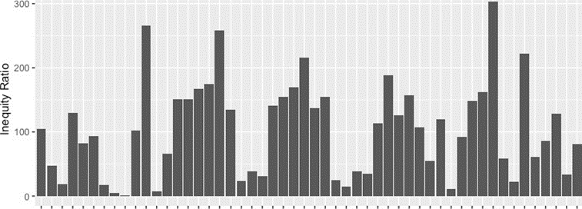
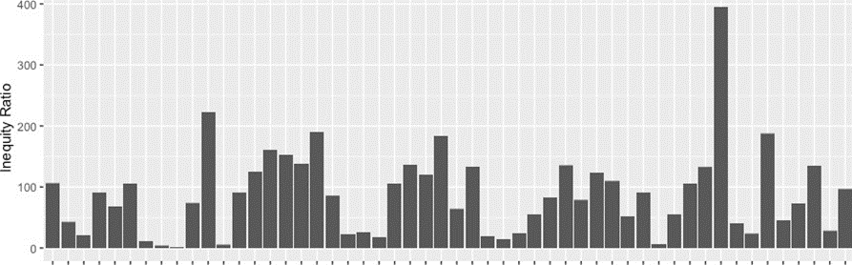
Homeownership Inequity Ratio: White alone vs. Asian alone
Homeownership Inequity Ratio: White alone vs.Hispanic or latino

Slide 11
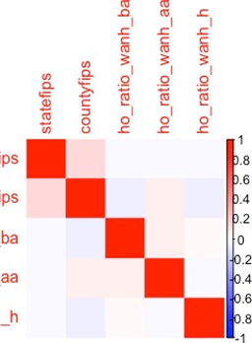
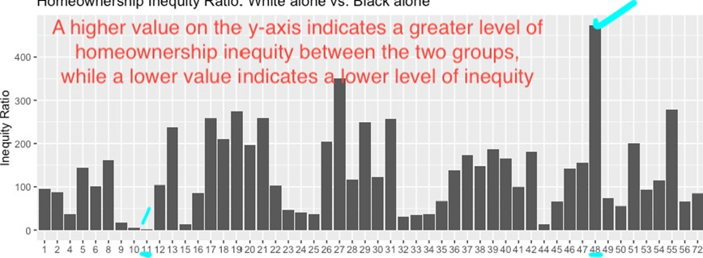

Slide 12
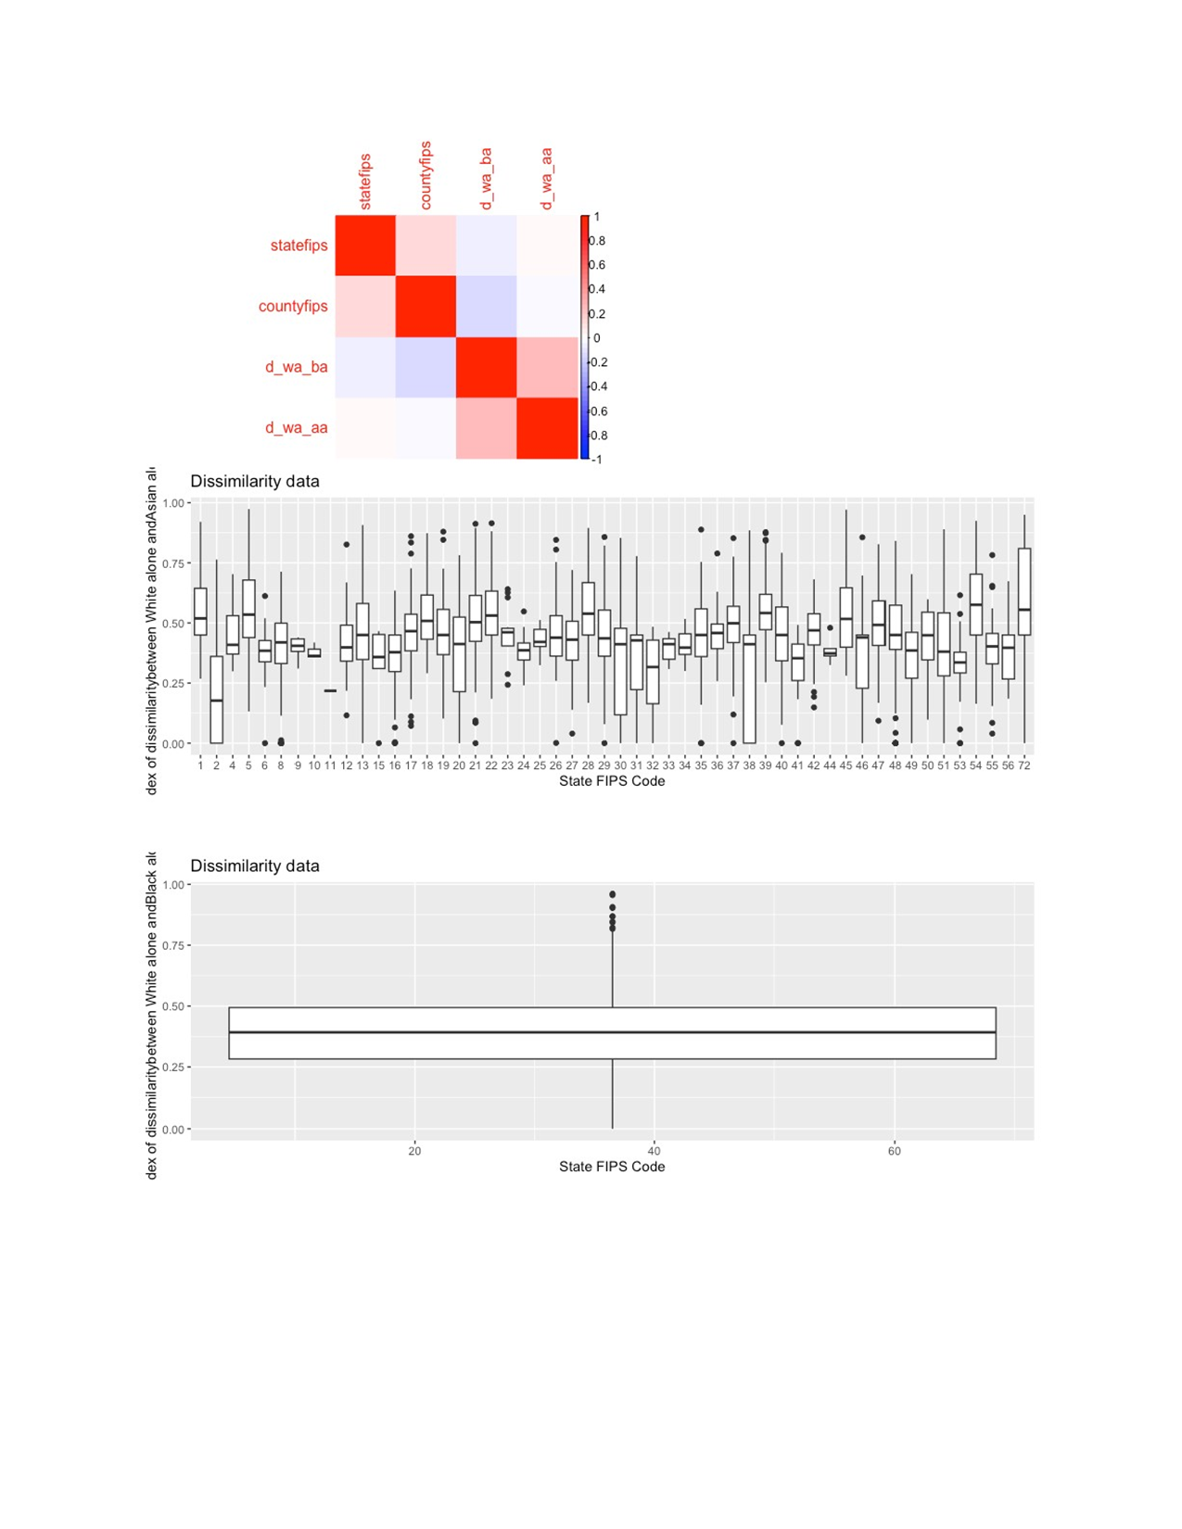

Slide 13
Challenges
Issue: Experienced difficulties when attempting to download a dataset from the IPUMS website.
Resolution: To address this issue, we have arranged a meeting with the IPUMS team.

Slide 14
Challenges
Issue: A communication breakdown within the team was initially observed.
Resolution: The issue was successfully addressed by scheduling team meetings more effectively.

Slide 15
QUESTIONS?

Slide 16
THANK YOU

